Slide 1
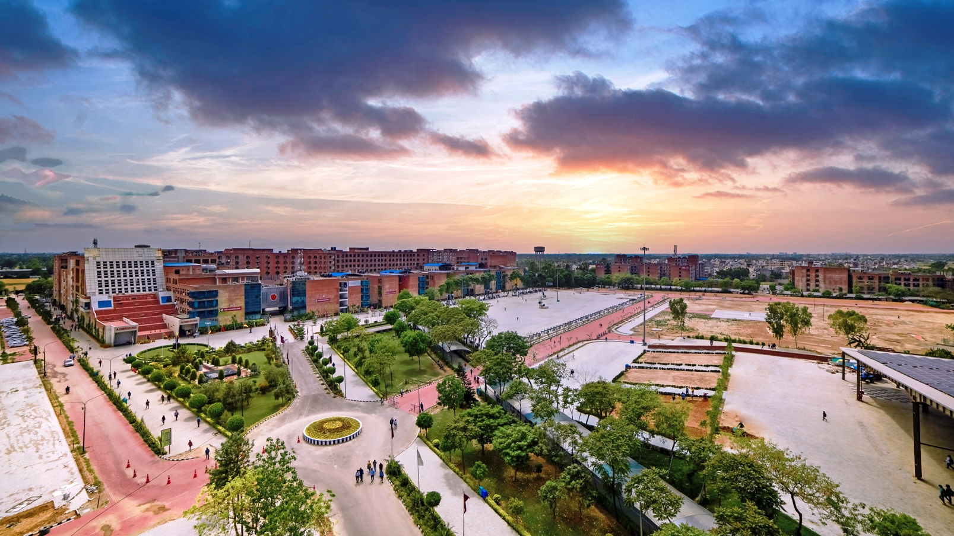
My class Interface

Slide 2
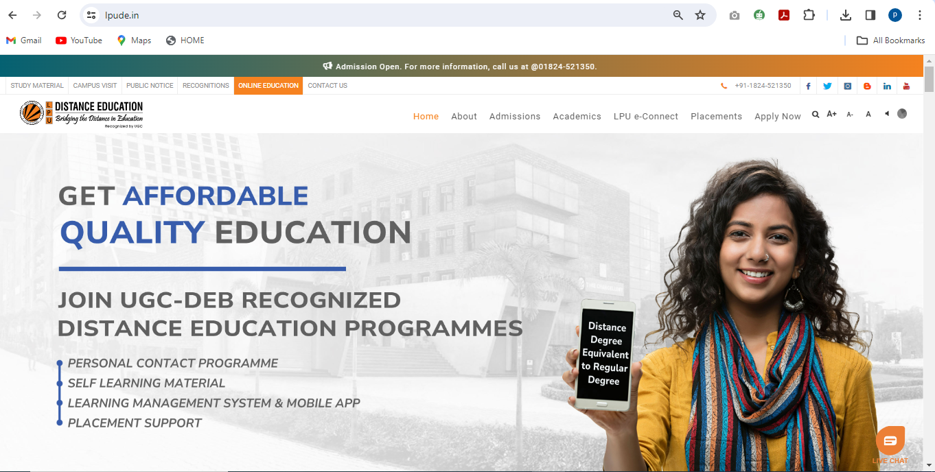
Direct Link for LPU Distance Education Website http://www.lpude.in

Slide 3
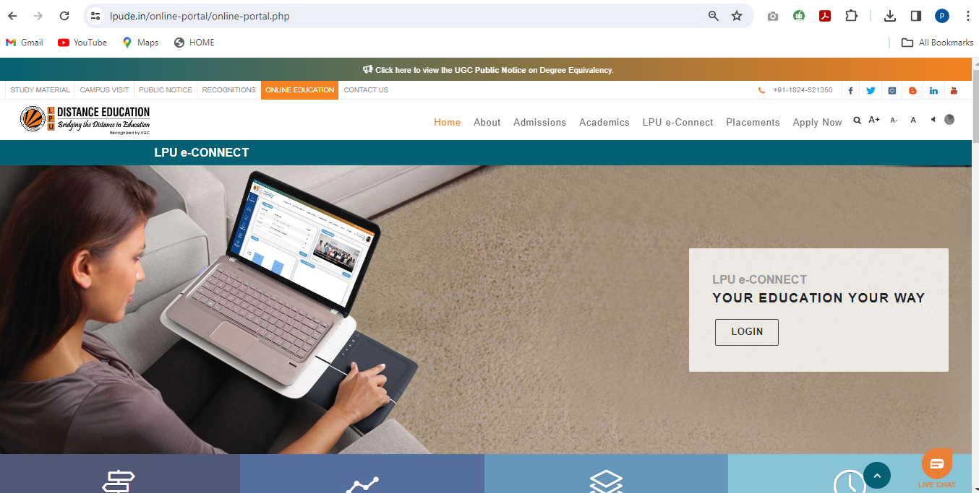
LPU e-Connect Login Screen for Students

Slide 4
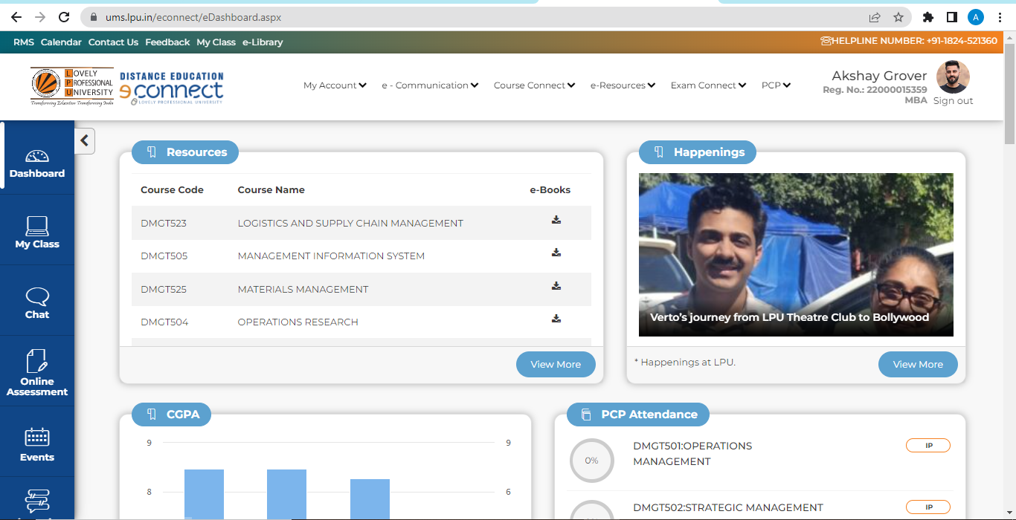
My Class Link on Dashboard

Slide 5
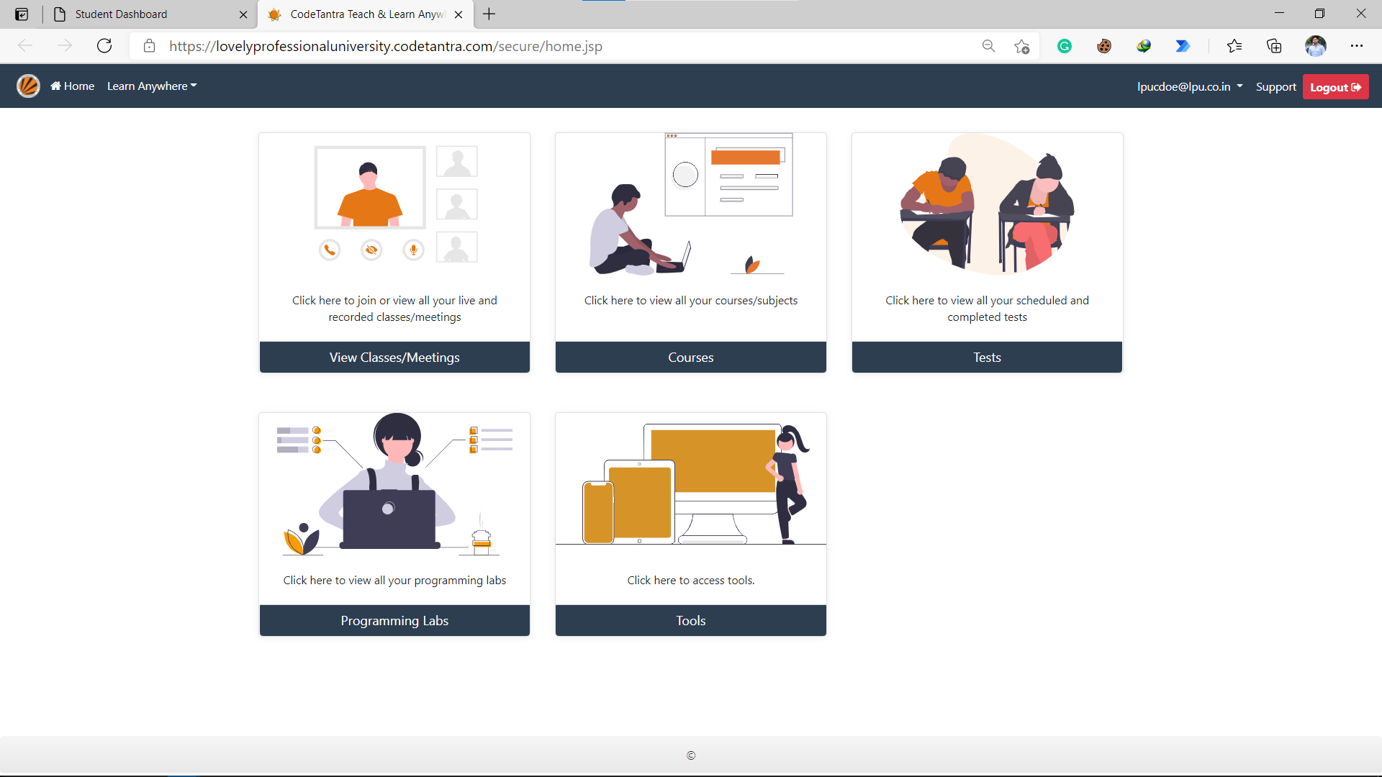

Slide 6
PCP Online Class

Slide 7
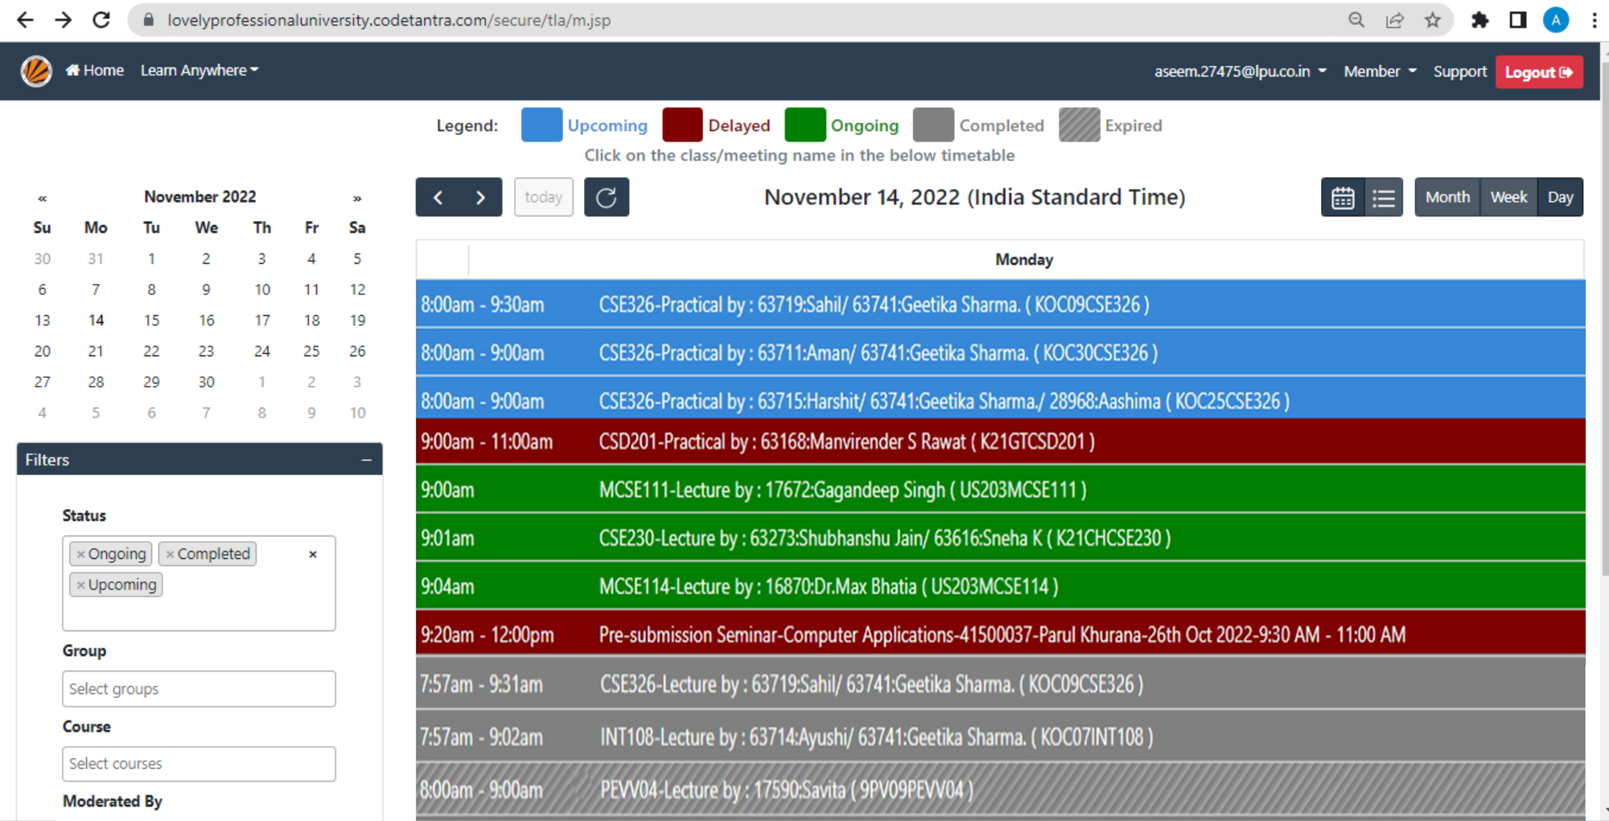

Slide 8
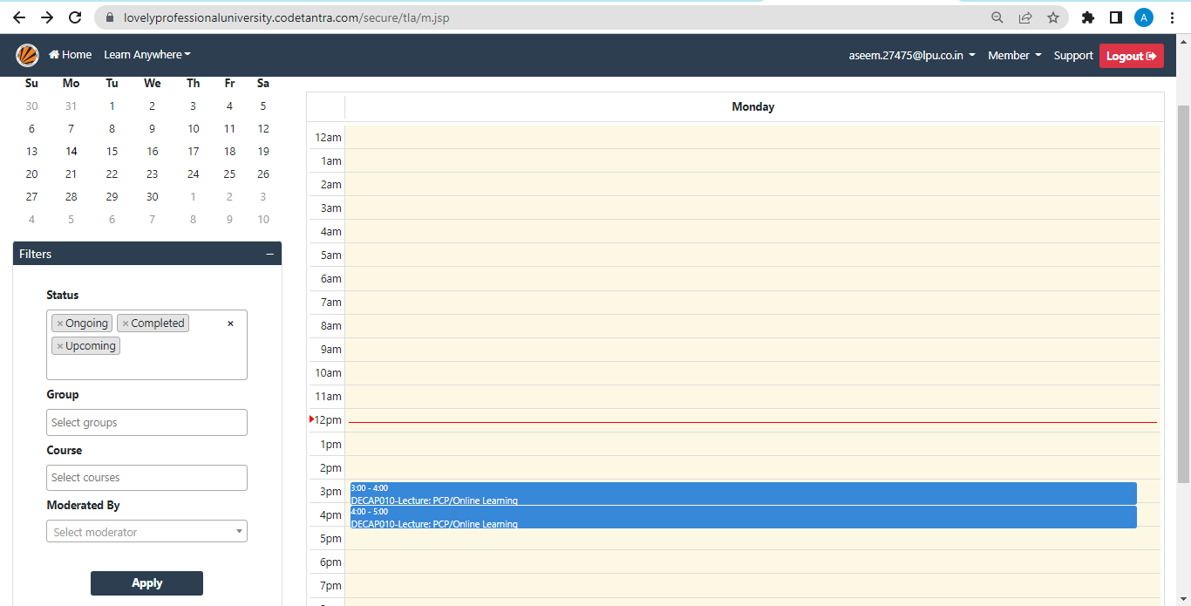
Scheduled Classes are shown in the calendar here

Slide 9
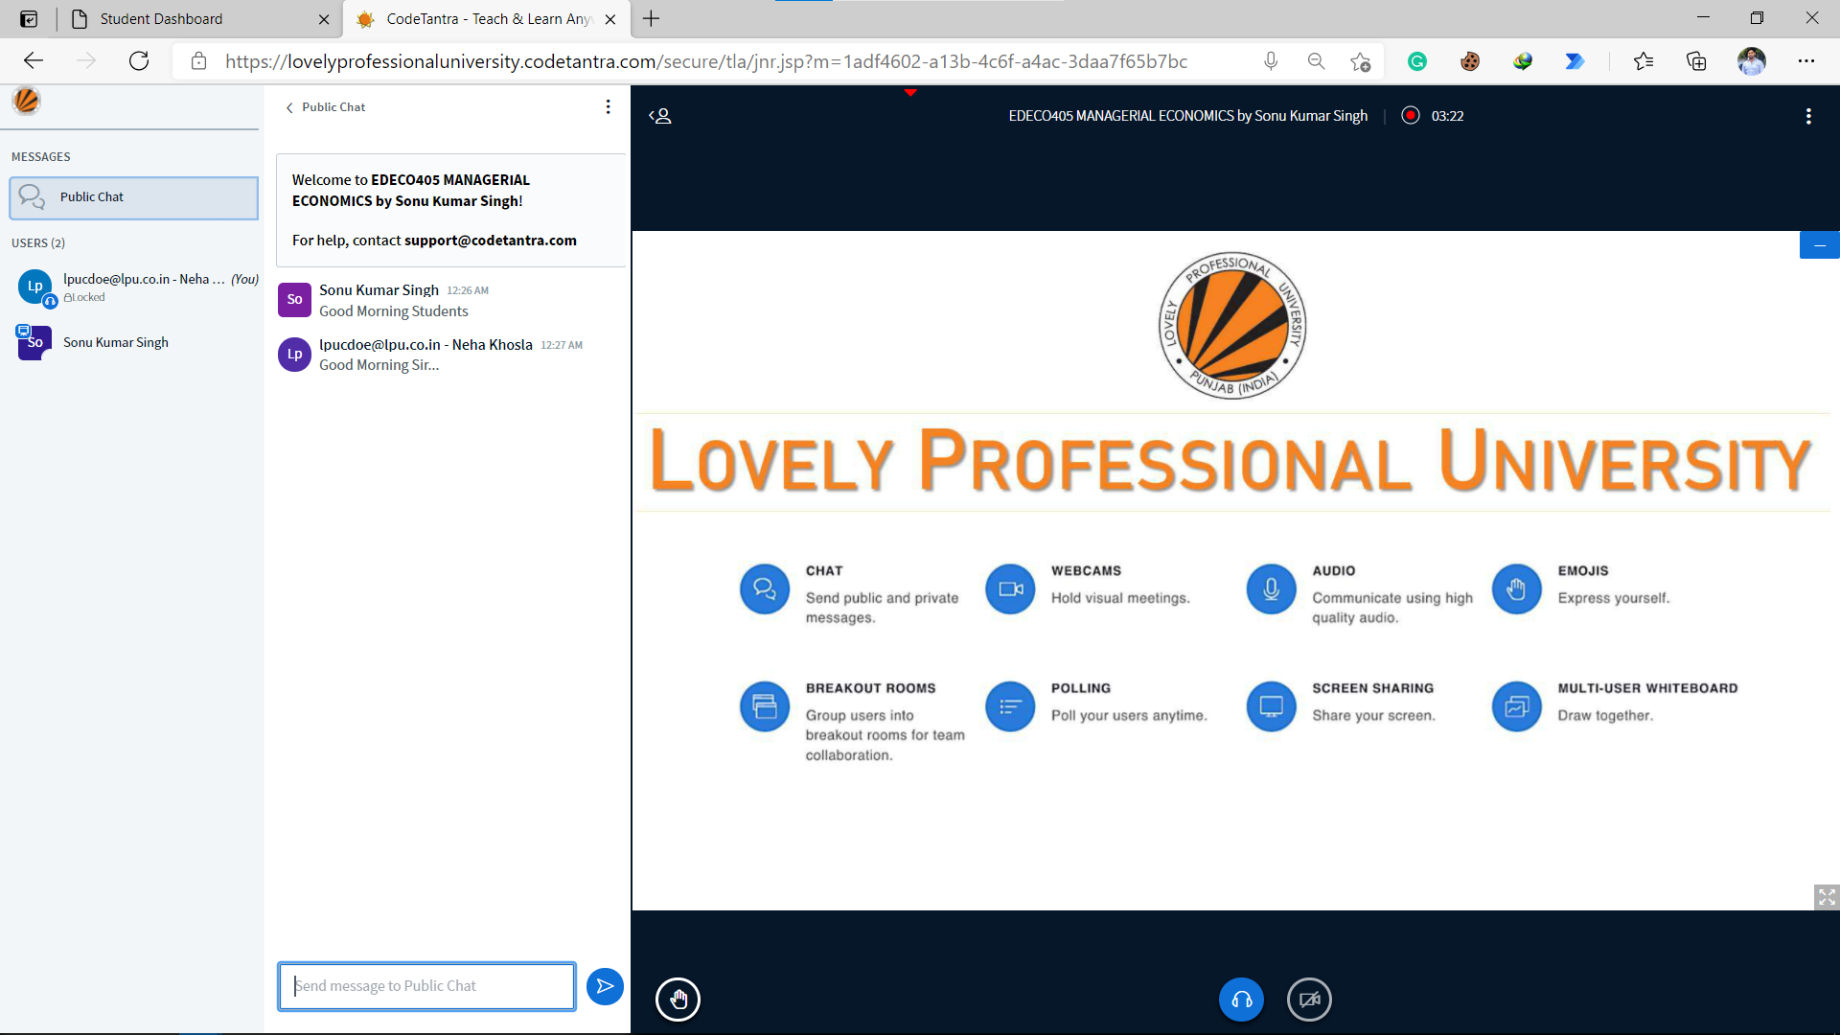

Slide 10
Presentation Area to view uploaded ppt by the teacher

Slide 11
Public chat area to communicate with either faculty member or classmates

Slide 12
List of participants of class

Slide 13
Buttons to raise hand and to control audio and video

Slide 14
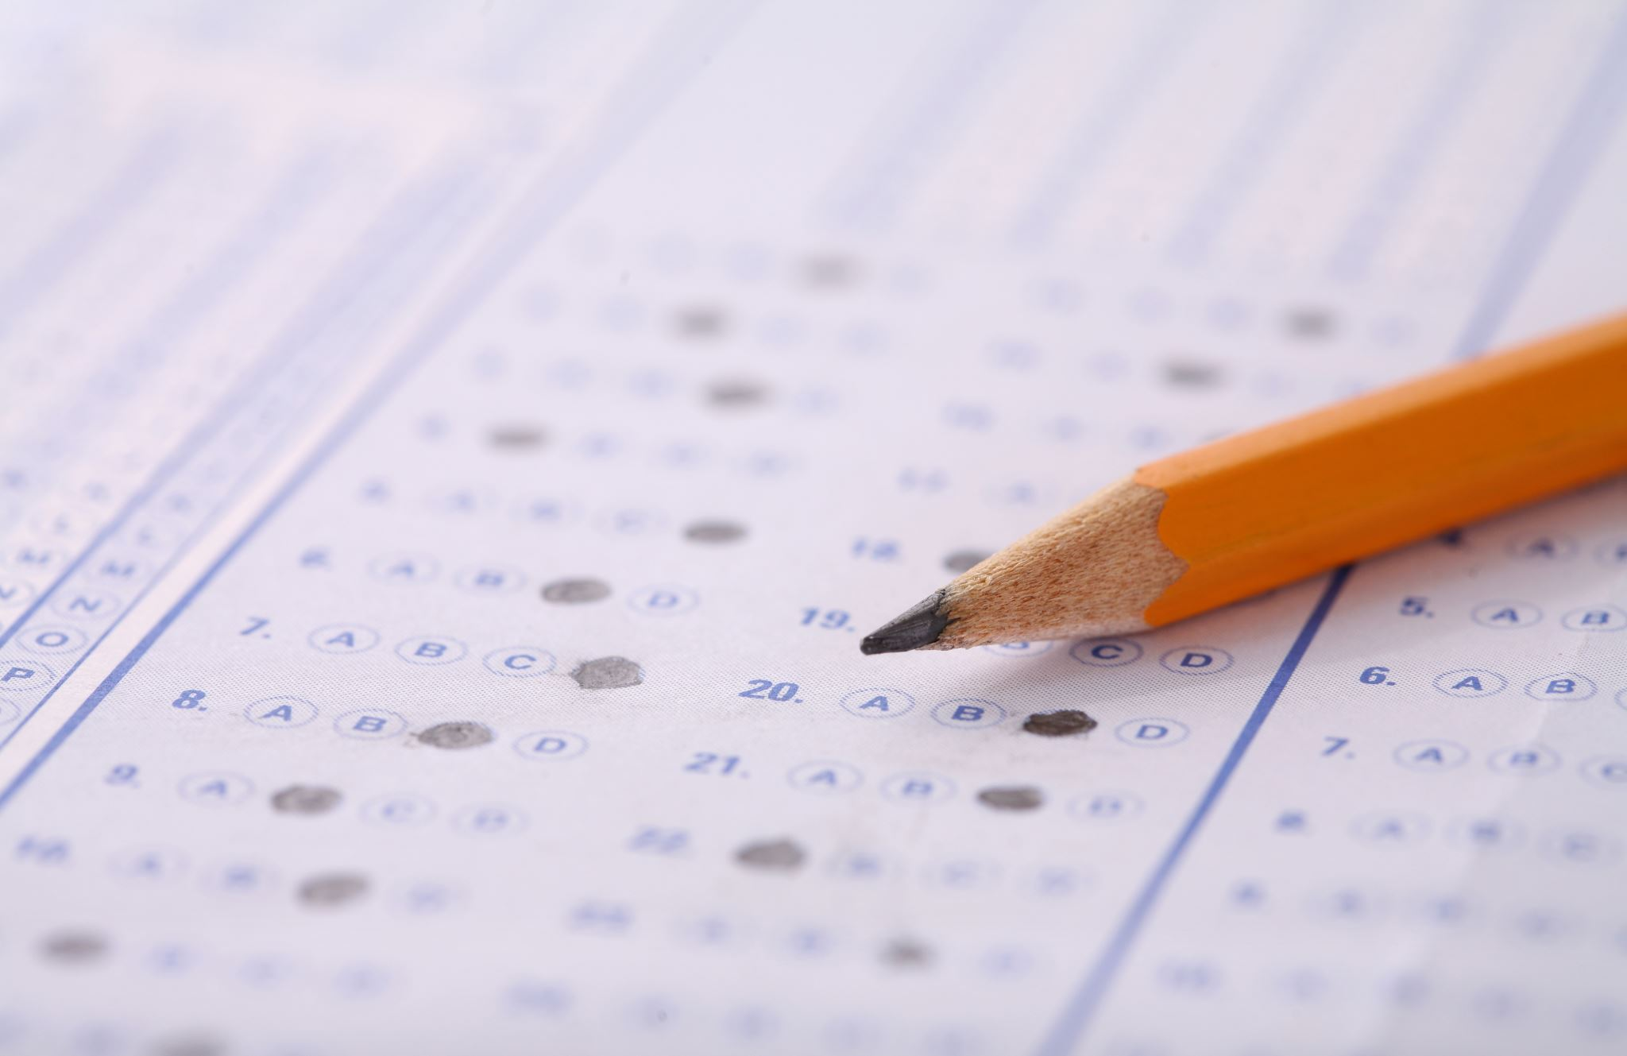
Quiz

Slide 15
Student Interface

Slide 16
Student Interface
Quiz questions are placed within the presentation file to be uploaded by the teacher and responses from students are collected through polling

Slide 17
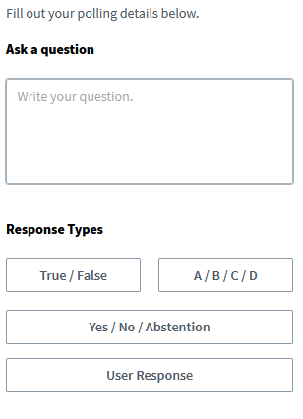
Teacher Interface

Slide 18
Student Interface
Polling Options

Slide 19
Teacher Interface
Realtime Analytics of the Student Response
Poll results can be published
Student who has not responded yet
Facility to track individual Student Response

Slide 20
Student Interface
Polling Options

Slide 21
Breakout Room

Slide 22
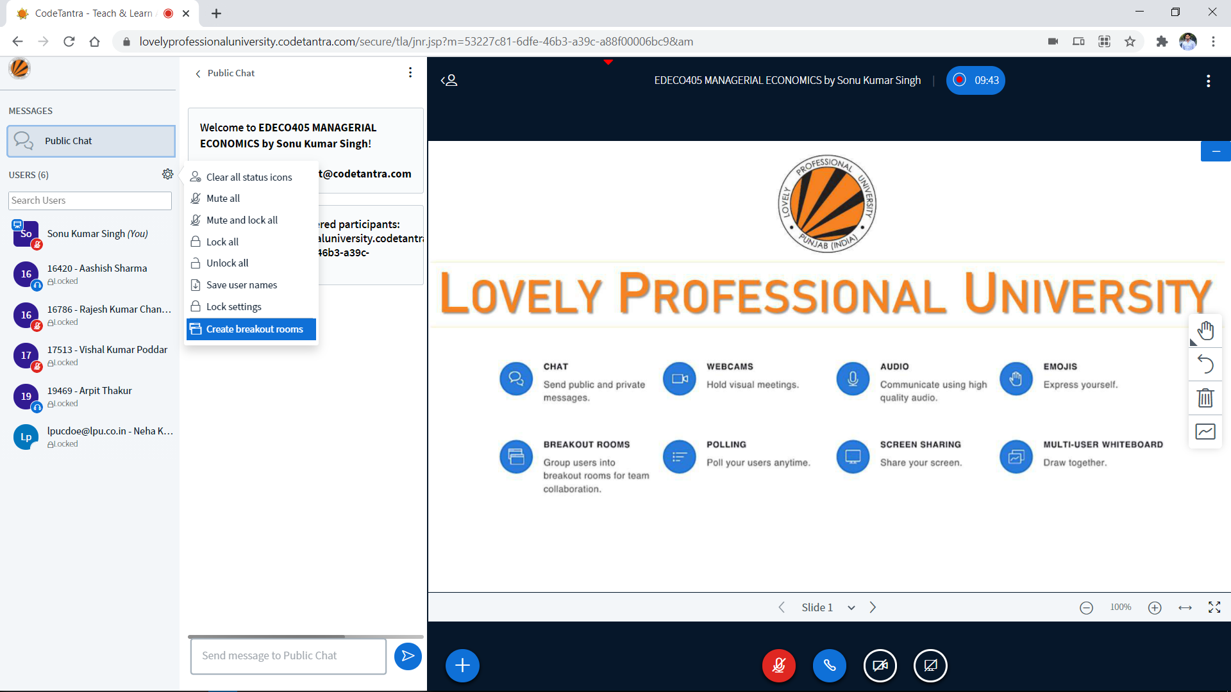

Slide 23
Integrated Breakout Room Features for Group Activity

Slide 24
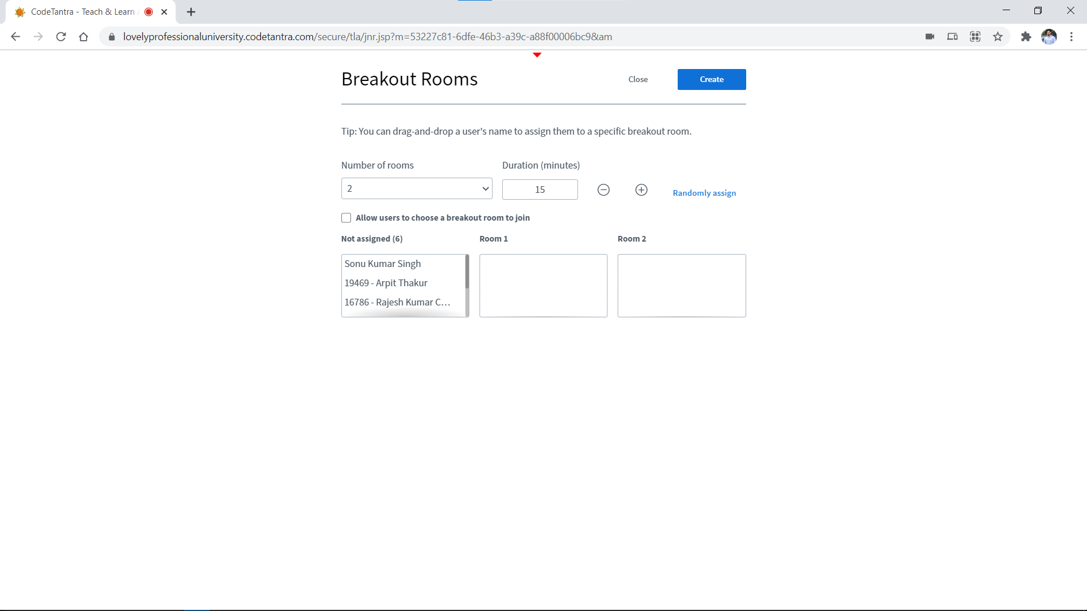

Slide 26
Teacher has control to create number of breakout rooms

Slide 27
Teacher has control to set duration for breakout rooms

Slide 28
Teacher has control to randomly assign students in created Breakout Rooms.

Slide 29
Teacher can allow students to choose the breakout room as per their choice.

Slide 30
List of all students is available for the teacher to assign students as his/her requirements.

Slide 31
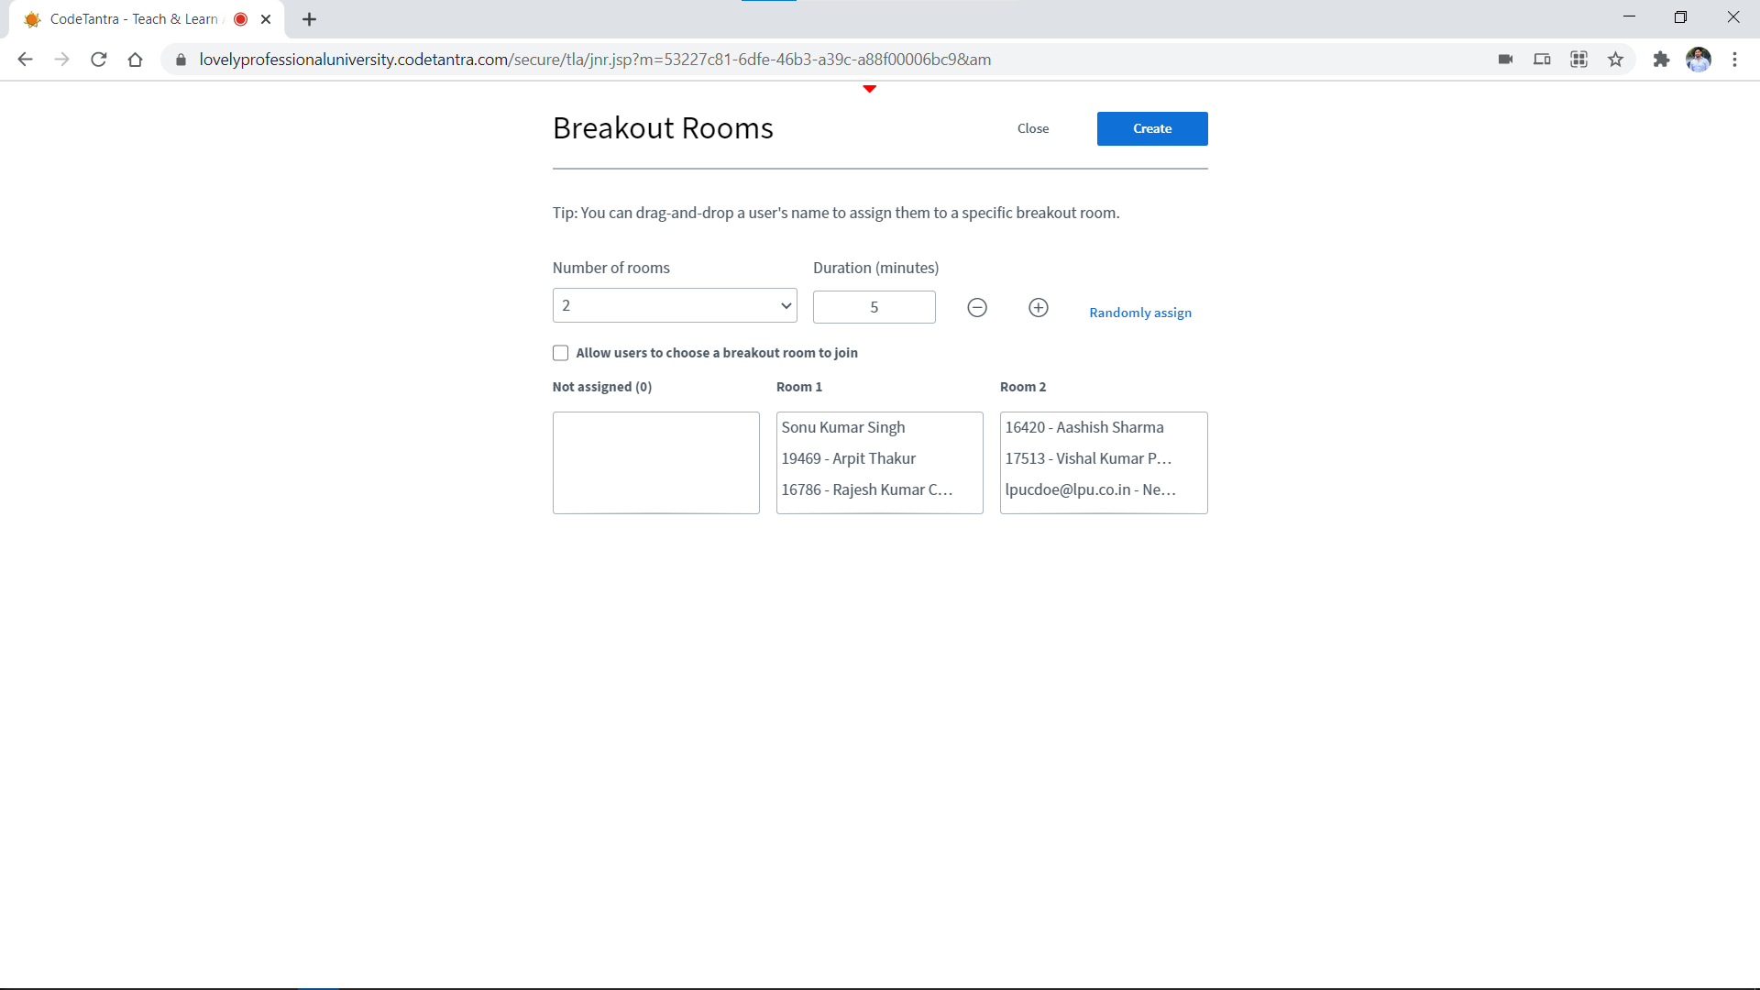
Example of Assignment of students into multiple Breakout rooms manually

Slide 32
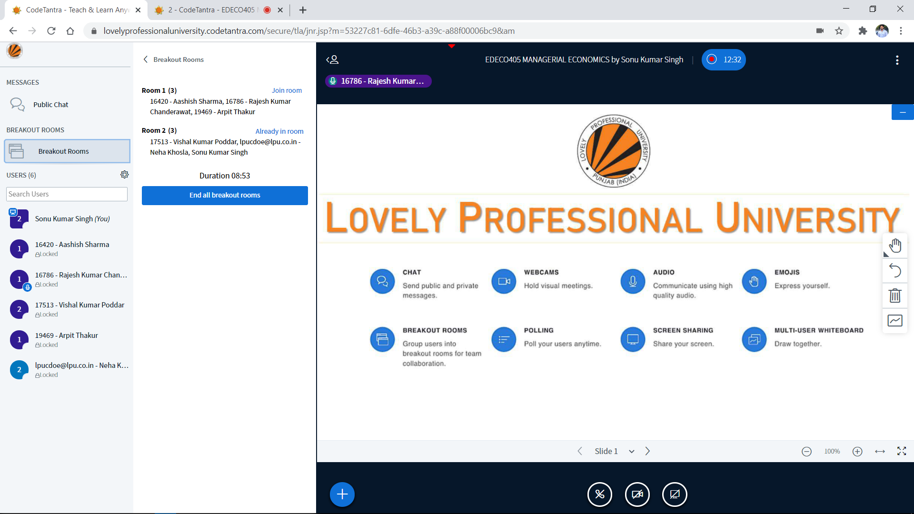

Slide 33
Lecture Recording

Slide 35
My Class

Slide 36
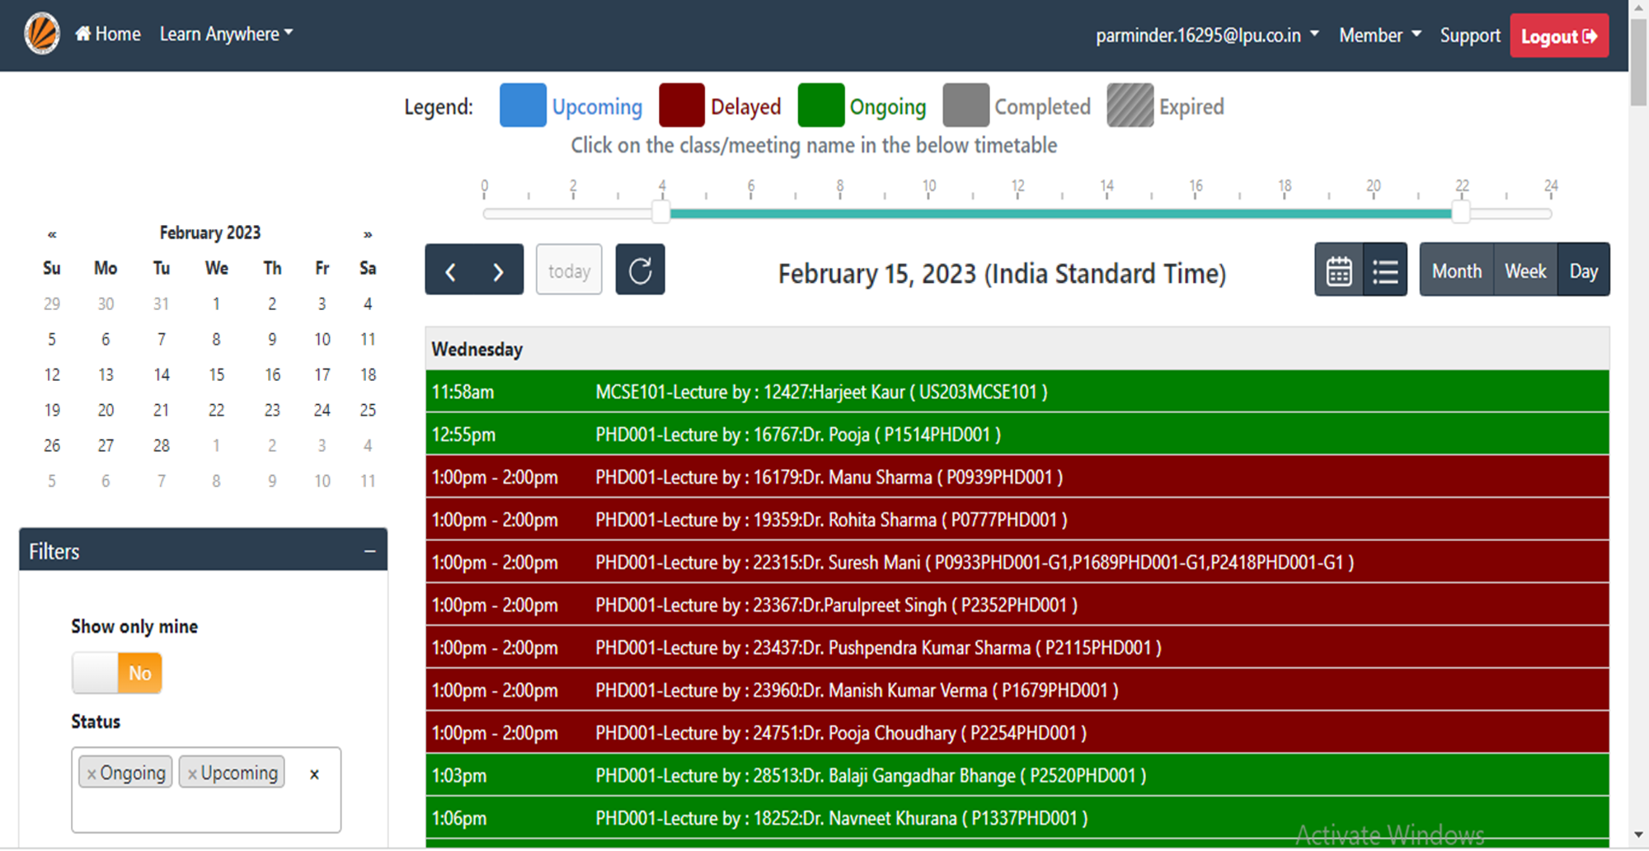

Slide 37
Select the appropriate date from the calendar

Slide 38
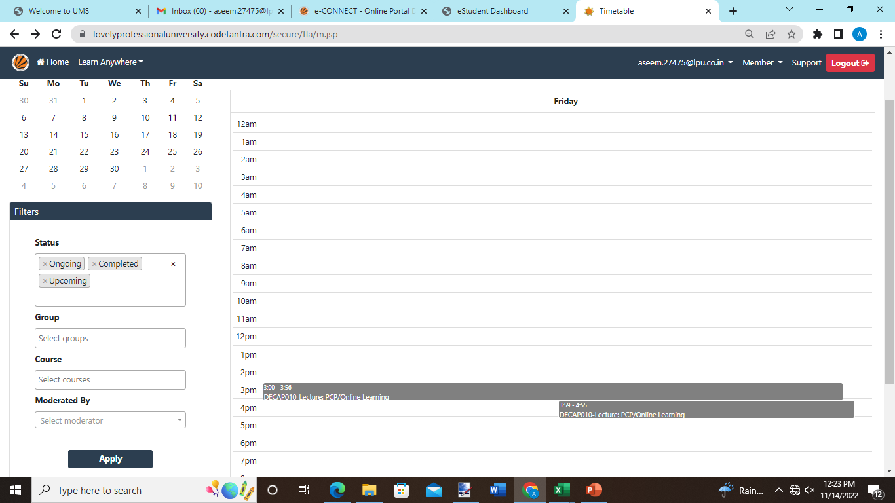
Select the right class to view the class details.

Slide 39
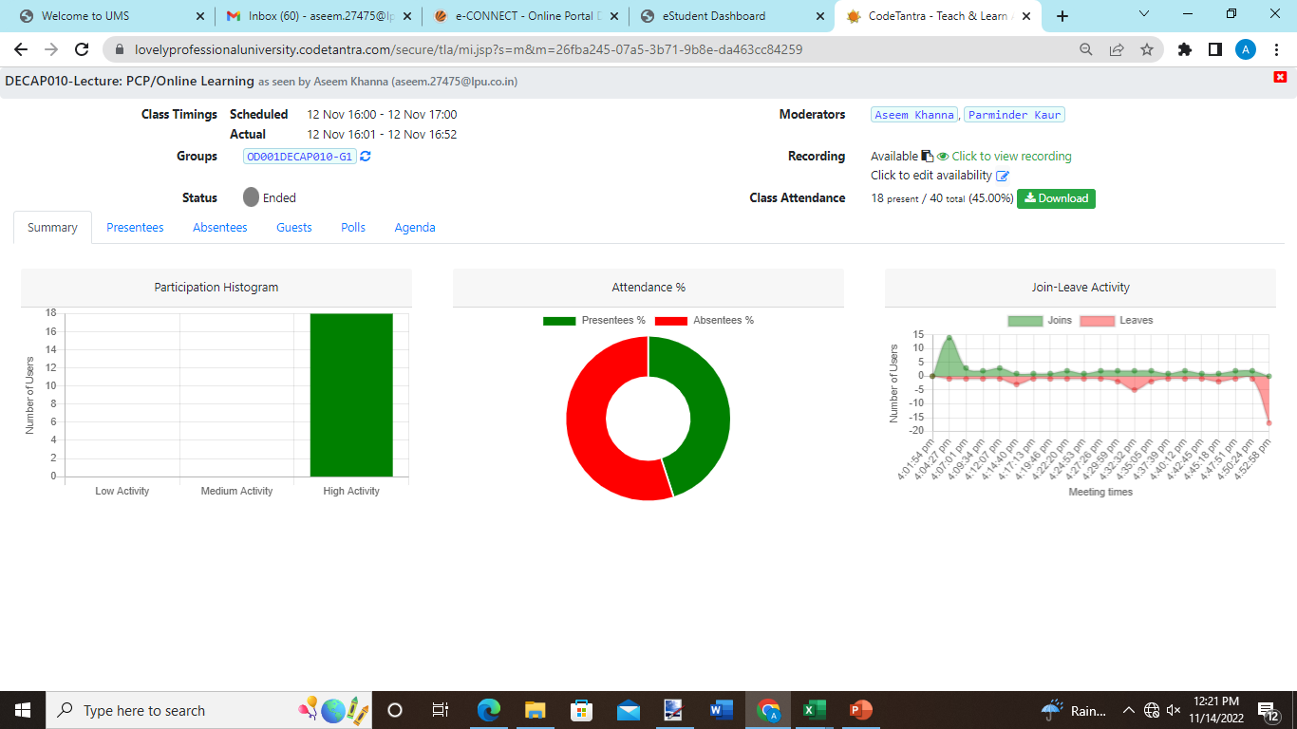

Slide 40
Select Click to view Recording link to view the recording

Slide 42
Thank you

