Slide 1
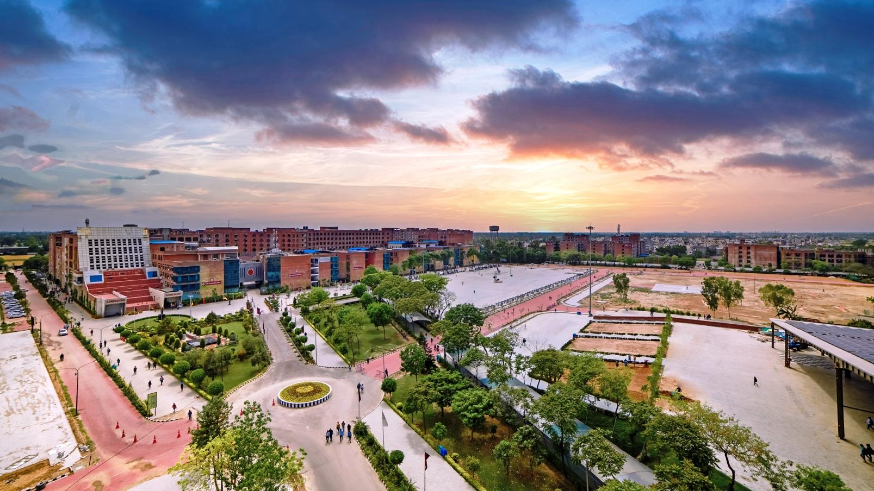
ACADEMIC DETAILS OF LPU DISTANCE EDUCATION

Slide 2
IMPORTANT DATES OF LPU DISTANCE EDUCATION
Activity | Applicable for Freshly Enrolled Students
PERSONAL CONTACT PROGRAMME CLASSES | DAY | DATE
Start date of PCP Classes | Tuesday | 21-Nov-23
Last date of PCP Classes | Wednesday | 20-Dec-23
CONTINUOUS ASSESSMENT | DAY | DATE
Availability of Assignments & Opening of Online Interface for Submission of Assignments by students through LPU e-Connect | Monday | 06-Nov-23
Last Date for Online Submission of Assignments by Students through LPU e-Connect | Thursday | 30-Nov-23
END TERM EXAMINATION | DAY | DATE
Publishing of Date Sheet on LPU e-Connect/Mobile App (Practical and Theory Courses) | Friday | 01-Dec-23
Start of End Term Examination (Practical and Theory Courses) | Friday | 22-Dec-23

Slide 3
ACADEMIC RESOURCE
Programme Guide: Contains detailed Programme Scheme and syllabus of all the courses with examination related weightages
Sample Programme Guide

Slide 4
Self Learning Material (SLM)
PCP Classes
Special Classes (Master Class / Guest lecture / Hands-on Workshop / Professional Enhancement Programme
LPU Live
ACADEMIC DELIVERY

Slide 5
1. Self Learning Material (SLM)
Self Learning Material (SLM): e-Book of SLM containing all the course content covering the entire syllabus of the course. It is written in the Self-Learning and conversational style and available on LPU e-Connect.
Content
Summary
Self Assessment Question
Review Question
Further Readings
Web Links
Sample SLM

Slide 6
2. Personal Contact Programme (PCP) Classes
Course-wise 12 Personal Contact Programme (PCP) classes by our expert faculty will be conducted for 12 consecutive days (2 weeks) as per dates given in important dates and Time table for the same will be published on e-Connect. For Practical subjects also, 12 PCP classes will be conducted by Faculty members. Keeping the interest of working students, recordings of PCP classes will be available on e-Connect.
Duration of Class: 1 Hour
Timing of Class: 9 AM to 5 PM
Platform: LPU e-Connect

Slide 7
Master Classes
Guest Lectures
Hands-up Workshops
Professional Enhancement Classes
3. Special Classes

Slide 8
Master Classes/Guest Lectures
LPU always believes in providing exposure to its students through Master Classes by great leaders and Guest Lectures by Industry experts & professionals. These Master Classes, Guest Lectures and Hands-on workshops will provide educational inputs to the students based on real life experiences.

Slide 9
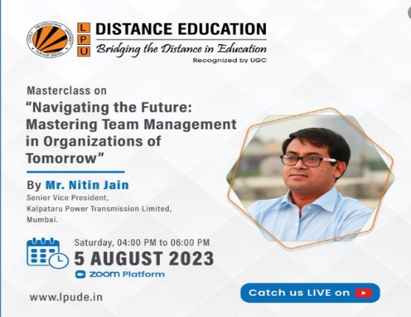
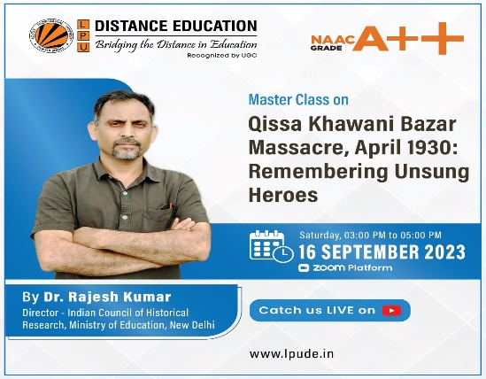
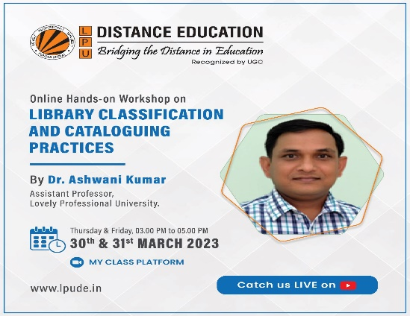
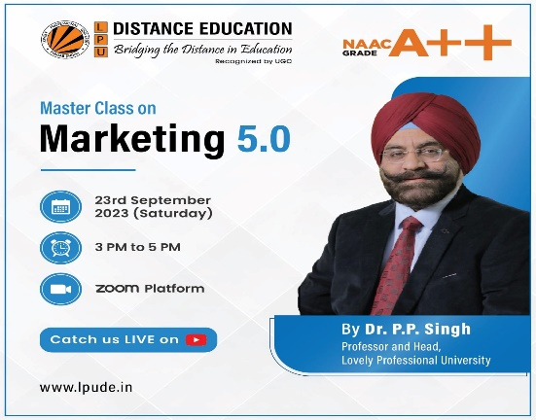
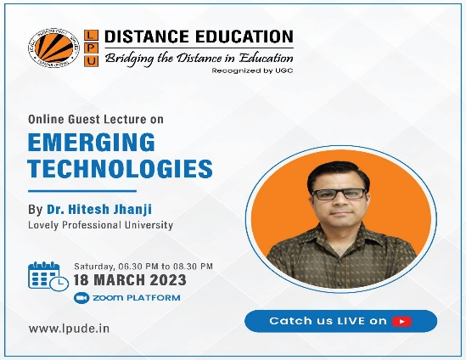
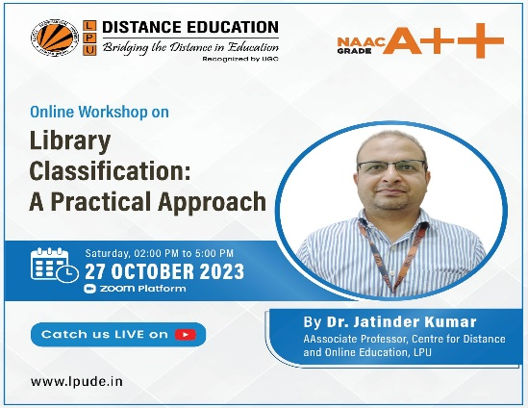
Master Classes/Guest Lectures/Workshops
Five Industry Expert Lectures, Guest Lectures and Master Classes have been conducted recently for LPU Distance Education students in fields of Management, Computer Application, Mathematics, Library Science, Punjabi, History and Hindi.
These lectures by prominent experts are conducted with a mindset to give LPU Distance Education students an industry oriented approach with topics based on their curriculum and general topics as well.
We have also conducted the Professional Enhancement guest lecture on Preparation of Banking Exams. We’ll continue to bring such opportunities for our students to make them future ready.

Slide 10
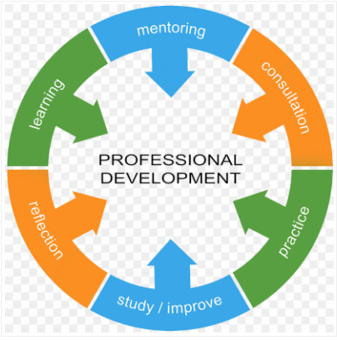
Professional Enhancement Classes
Special classes are organized under Placement Enhancement Program (PEP) where students are trained in aptitude, reasoning, soft skills, interviewing skills, right from the course commencement till their placements.
Objective of Professional enhancement programme is to enhance students’ capabilities as per the career requirements, to create awareness and motivate to acquire add on skills other than their subject.

Slide 11
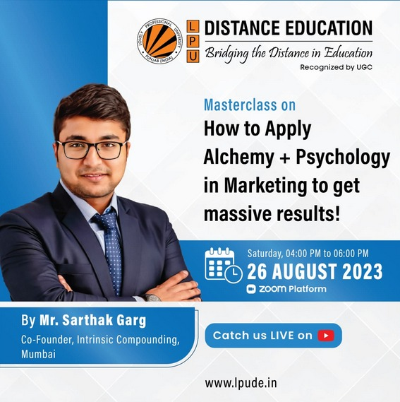
Professional Enhancement Classes

Slide 12
5. LPU Live
Chat: Students can interact with their concerned faculty and peer Students through chat using LPU Live Messenger during PCP classes.

Slide 13
Thank you

